Slide 1
ONLINE IT SERVICE TRACKING SYSTEM
Team Members
ROBIN ROY
GURUBARAN T
SATISH KUMAR ARUMUGASAMY
VIBHASH KUMAR S
CHANDRU KRISHNA S
Under the Guidance of
MR.R.MATHUNITHI B.E

Slide 2
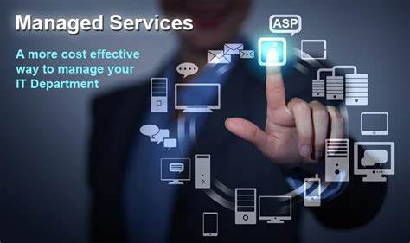
INTRODUCTION
This presentation discusses the implementation of an efﬁcient online tracking system with Asp.net. The goal is to improve IT support services and minimize downtime.

Slide 3

ABSTRACT
Online IT service Tracking System is a set of programs which run as a software providing assistance to all the complaints, queries and IT services to the customers within a set of organization. It is web based software which has made the working procedure of organization much this project is aimed at developing a simple IT service tracking for the facilities in the Companies, Industries and institute.

Slide 4

BENEFITS OF AN ONLINE TRACKING SYSTEM
Efﬁcient IT Support: An online tracking system provides beneﬁts such as real-time updates, transparency, and improved communication.
These beneﬁts lead to increased productivity and revenue.

Slide 5

PROJECT DESCRIPTION
Online IT service tracking system is a web-based application designed to help businesses manage their IT services efficiently. The system enables IT teams to track, manage, and resolve IT service requests in a timely and organised manner.The system includes a user-friendly interface that allows employees to submit IT service requests through a ticketing system. These requests are then automatically assigned to the appropriate IT staff member based on their skillset and availability

Slide 6

FEATURES OF THE ONLINE TRACKING SYSTEM
Efﬁcient Tracking: The online tracking system will include features such as real-time ticket updates, automated notiﬁcations, and a user-
friendly interface. These features will simplify the IT support process and improve
user experience. And new features, improving existing functionality, enhancing performance, and ensuring compatibility with new technologies

Slide 7
SOFTWARE REQUIREMENT
Operating System | Microsoft windows 10 (64-bit)
Processor | Intel core i5 3.80 GHz
Storage | 8 GB of available disk space minimum
IDE | Visual studio 2019

Slide 8
OVERVIEW OF PROJECT
An online IT service tracking system using ASP.NET is a web-based application that allows IT professionals to track and manage the status of service requests submitted by users The system provides an efficient and effective way to manage IT service requests by automating the workflow and providing a centralised location to track service requests.The system typically includes a web interface that allows users to submit service requests, view the status of their requests, and provide feedback on the service provided.

Slide 9
FEATURE ENHANCEMENT
Mobile App
Develop a mobile application that enables customers and support staff to access the system and manage service tickets from their smartphones. This will make it easier for customers to submit tickets and for support staff to track and respond to tickets on the go.
Chatbot Integration
Integrate a chatbot that can answer common customer inquiries and automatically route service tickets to the appropriate support staff.
AI-based Ticket Routing
Use machine learning algorithms to analyse the content of service tickets and automatically route them to the most appropriate support staff based on their skillset and workload.

Slide 10
CONCLUSION
In conclusion, the online IT service tracking system developed using ASP.NET is a powerful tool for businesses to efficiently manage their IT service requests With its user-friendly interface, customizable workflows, and automated processes, it allows IT teams to streamline their workflow and track the progress of service requests in real-time.The system provides an easy-to-use interface for users to submit and track their service requests, reducing the need for manual intervention and improving communication between IT staff and end-users.

